Slide 1

Customer Shopping Behavior Analysis
Uncovering insights from 3,900 purchases to guide strategic business decisions through data-driven analysis of spending patterns, customer segments, and product preferences.

Slide 2
DATASET OVERVIEW
The Foundation: Our Data
3,900
18
50
Total Purchases
Data Points
Locations
Transactions analyzed
Features per customer
Geographic coverage
Key Features Tracked
Customer demographics: Age, Gender, Location, Subscription Status
Purchase details: Item, Category, Amount, Season, Size, Color
Shopping behavior: Discounts, Promo Codes, Previous Purchases, Review Ratings, Shipping Type

Slide 3

PYTHON ANALYSIS
Data Preparation & Cleaning
01
Data Loading & Exploration
Imported dataset with pandas, examined structure and summary statistics
02
Missing Data Handling
Imputed 37 missing Review Rating values using median by product category
03
Feature Engineering
Created age_group bins and purchase_frequency_days columns
04
Database Integration
Connected to PostgreSQL and loaded cleaned data for SQL analysis

Slide 4
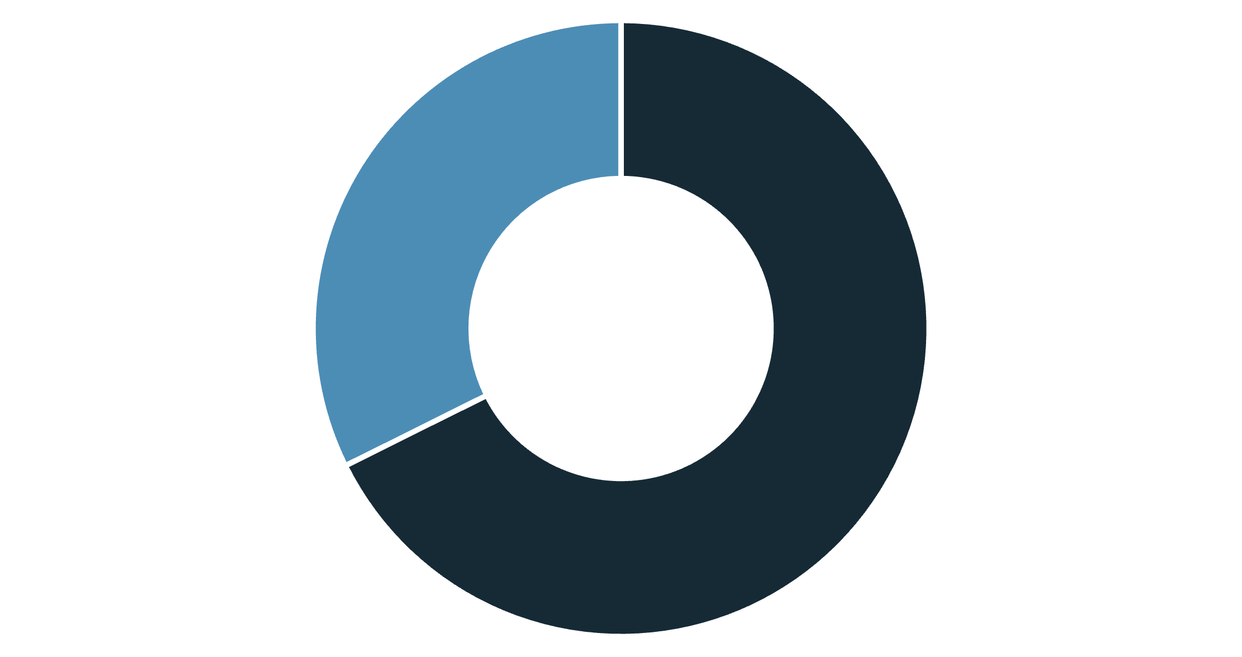
SQL INSIGHTS
Revenue Analysis by Gender
Male Customers Drive Revenue
Male customers generated $157,890 in total revenue compared to $75,191 from female customers—representing 68% of total sales.
This significant disparity suggests opportunities for targeted marketing campaigns to increase female customer engagement and spending.
Male
Female

Slide 5
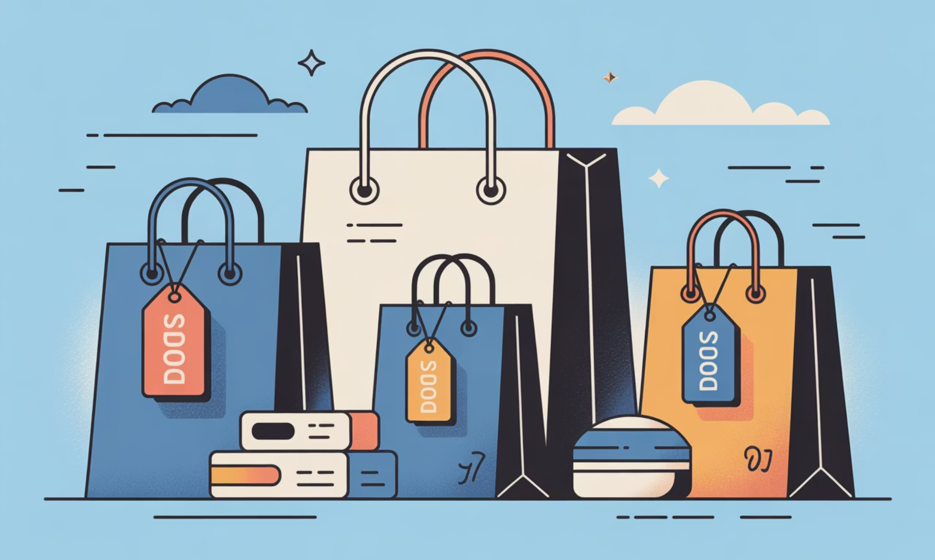
Smart Shoppers: Discount Users Who Spend Big
High-Value Discount Customers
Identified 839 customers who used discounts but still spent above the average purchase amount of $59.76.
These savvy shoppers represent a valuable segment—they're discount-motivated but willing to spend on higher-ticket items.
Top spenders ranged from $62 to $97 per transaction while utilizing promotional offers.

Slide 6


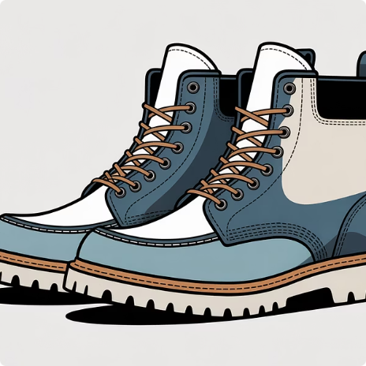

PRODUCT PERFORMANCE
Top-Rated Products & Category Leaders
Gloves
Sandals
Boots
Hat
Highest rated at 3.86 stars
Strong rating of 3.84 stars
Rated 3.82 stars by customers
Solid 3.80 star rating
Clothing leads with $100K revenue and 2,000 sales, followed by Accessories at $70K. Footwear and Outerwear show growth potential.

Slide 7

Shipping Preferences & Customer Segments
Returning (701)
Loyal (3,116)
Shipping Type Impact
Express shipping customers spend slightly more on average ($60.48) compared to Standard shipping ($58.46).
This $2 difference suggests premium shipping attracts higher-value customers willing to pay for convenience.
New (83)
Loyal customers dominate at 80% of the base, presenting opportunities to convert New and Returning segments.

Slide 8
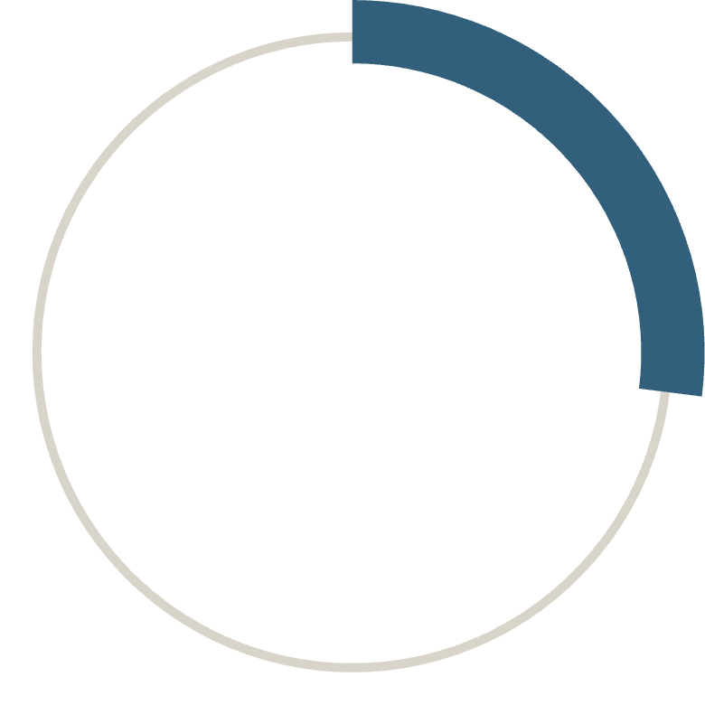
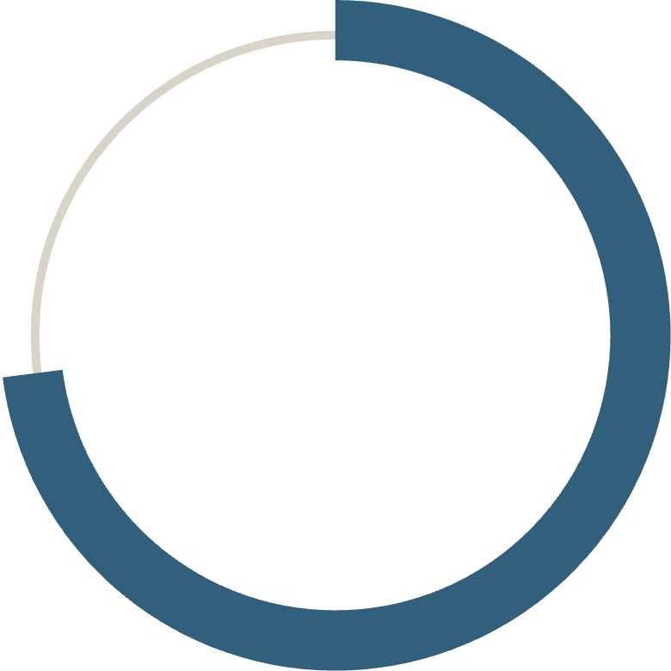
SUBSCRIPTION ANALYSIS
Subscription Status Breakdown
27%
73%
Subscribers
Non-Subscribers
1,053 customers
2,847 customers
Key Insight
Despite similar average spend ($59.49 vs $59.87), non-subscribers generate 2.7x more total revenue due to volume.
Of 3,476 repeat buyers (5+ purchases), only 958 are subscribers—revealing a massive conversion opportunity.

Slide 9
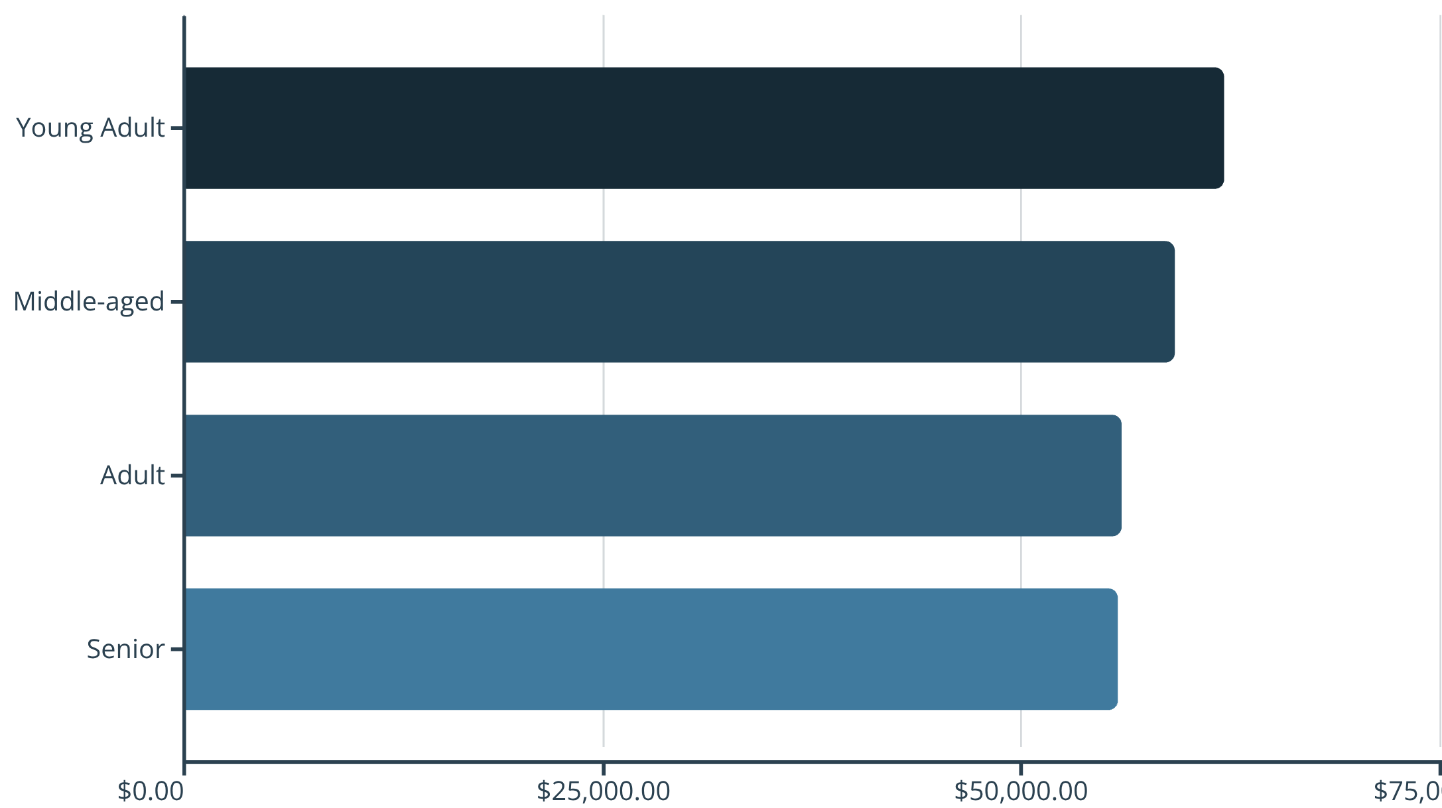
Revenue Distribution by Age Group
Balanced Demographics
Revenue is relatively evenly distributed across age groups, with Young Adults leading at $62K.
The narrow range ($6K difference) indicates broad market appeal and suggests age-agnostic product positioning is working effectively.

Slide 10

RECOMMENDATIONS
Strategic Action Plan
Boost Subscriptions
Loyalty Programs
Review Discount Policy
Product Positioning
Target 2,518 repeat buyers with exclusive benefits to convert them into subscribers
Reward repeat buyers to accelerate movement into the Loyal segment
Highlight top-rated items like Gloves and Sandals in marketing campaigns
Balance promotional sales boosts with margin control for sustainable growth
Targeted Marketing
Focus on Young Adults and express-shipping users for maximum ROI

